Slide 1
Ai chatbot
PROJECT REVEW 2
SHREYANSH SONI 22BET10037
SUPERVISOR- DR. VINEET JOSHI
PROGRAM CHAIR- DR.M. MURUGESWARI

Slide 2
INTRODUCTION
In today's rapidly evolving technological landscape, proficiency in programming languages has become an indispensable skill. However, mastering these languages can often seem daunting, especially for beginners. To address this challenge and revolutionize the learning experience, we are thrilled to introduce our innovative solution: a Chatbot for Teaching Programming Languages.
This groundbreaking chatbot aims to democratize access to programming education by providing a personalized and interactive learning environment. Whether you're a novice eager to dive into the world of coding or an experienced developer seeking to enhance your skills, our chatbot is designed to cater to your individual needs and learning pace.

Slide 3
PROBLEM STATEMENT
These challenges include:
Lack of Personalized Guidance: Traditional programming tutorials and courses may not cater to the individual learning needs and preferences of learners, resulting in a one-size-fits-all approach that fails to optimize learning outcomes.
Limited Interactivity: Passive learning methods, such as reading textbooks or watching video tutorials, may lack interactivity, making it difficult for learners to actively engage with the material and apply their knowledge in practical scenarios.
Difficulty in Seeking Help: Learners frequently face hurdles when seeking assistance or clarification on programming concepts, especially outside of structured learning environments. This lack of immediate support can lead to frustration and demotivation.

Slide 4
Overwhelming Content: The vast amount of programming language documentation, tutorials, and online resources available can be overwhelming for beginners, making it challenging to navigate and prioritize essential learning materials.
Time Constraints and Flexibility: Busy schedules and time constraints may limit learners' ability to dedicate consistent time to mastering programming languages, necessitating flexible learning solutions that accommodate their availability and pace.
Retention and Application: Without opportunities for hands-on practice and reinforcement, learners may struggle to retain newly acquired knowledge and apply it effectively in real-world projects and scenarios.

Slide 5
LITEATURE REVIEW
In recent years, the field of education has witnessed a significant shift towards leveraging technology to enhance learning experiences. One emerging technology that holds great promise in this regard is chatbots. Chatbots, powered by artificial intelligence (AI) and natural language processing (NLP) algorithms, have the potential to revolutionize programming education by providing personalized, interactive, and accessible learning experiences. This literature review explores existing research and developments in the use of chatbots for teaching programming languages, highlighting their potential benefits, challenges, and implications for the future of programming education.
Research by Kizilcec et al. (2017)
Study by Mitrovic et al. (2018)
Research by Ribeiro et al. (2020)
Studies by Kumar et al. (2019) and Zhou et al. (2021)

Slide 6
Existing work with limitations
Limited Language Support
Limited Interactivity and Contextual Understanding
Lack of Integration with Learning Manage
Limited Support for Complex Topics
User Interface Design and Accessibility

Slide 7
Hardware and software requirements
Basic Hardware Requirements:
Server:
A basic server with sufficient computing resources to host the chatbot application and handle user requests.
Minimum requirements may include a dual-core processor, 2GB of RAM, and 20GB of storage.
Network Connectivity:
Stable internet connection to ensure continuous communication between the chatbot server and users' devices.

Slide 8
Basic Software Requirements:
Programming Language and Framework:
Choose a programming language and lightweight web framework suitable for chatbot development.
Example: Python with Flask or Node.js with Express.js.
Development Environment:
Text editor or integrated development environment (IDE) for writing and editing code.
Example: Visual Studio Code, Sublime Text, or Atom.
Natural Language Processing (NLP) Library:
Integrate a basic NLP library to enable the chatbot to understand and respond to user queries.
Example: NLTK (Natural Language Toolkit) for Pyt
hon.

Slide 9
Web Server:
Install a basic web server to host the chatbot application.
Example: Apache HTTP Server or Nginx.
Database:
Set up a lightweight database to store user data and chat histories if necessary.
Example: SQLite for small-scale deployments.

Slide 10
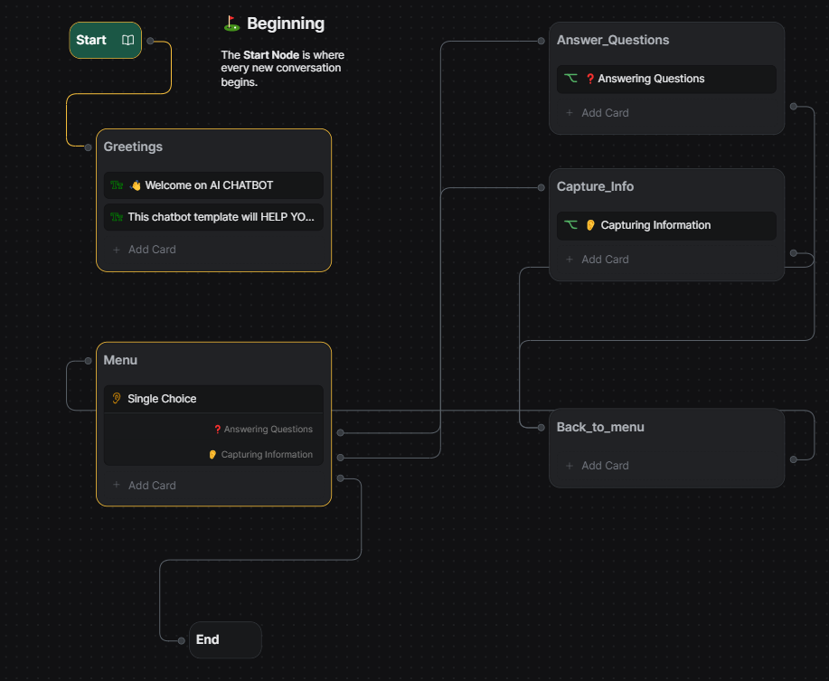
System architecture

Slide 11
PROJECT TIMELINE
THIS PROJECT HAS 6 CRUCIAL PHASES:
Phase 1: Planning and Preparation
Phase 2: Design and Prototyping
Phase 3: Development
Phase 4: Testing and Quality Assurance
Phase 5: Deployment and Launch
Phase 6: Post-Launch Activities and Iteration

Slide 12
REFERENCES
SOME OF THE MAJOR SOURCE OF INFORMATIONS ARE:
CHATGPT3.5- https://chat.openai.com/
GITHUB- https://github.com/Shreyansh-Soni23/ai-tutor/import
BOTPRESS- https://studio.botpress.cloud/93c76865-9302-45b3-b4a5-067ab878f64d/flows/wf-main
CODEACADEMY- https://www.codecademy.com/
YOUTUBE(CODE WITH HARRY)- https://www.youtube.com/watch?v=PGaiZfjJZi0&t=37s

Slide 13

22BET10037
SHREYANSH SONI

